Slide 1
Adaptive covariance inflation error correction
Qingyun Ren
Mu Niu

Slide 2
Problem statement
Underestimate the ensemble variance
Poor performance
Filter divergence: Filter no longer respond to observation.

Slide 3
Solution
Covariance inflation
Increasing its variance by pushing ensemble members away from the ensemble mean
Localization
Correct errors in the sample covariance between observations and model state variables
Often use covariance inflation based on assumptions below:
Both localization and inflation are homogeneous in both space and time
Inflation values are homogeneous in space but adaptive in time

Slide 4

Bayesian filtering
Model:
Assumption:
Observations within the set $y_{a}$ also have independent observation errors

Slide 5
Ensemble filters
Use Monte Carlo methods
To approximate the solution
To advance estimates of the state probability distribution function in time
Derivative from Kalman filter with adjustment
Prior ensemble estimation y’s mean and variance:
Increments (N is the ensemble size, M is the model size)

Slide 6

Error source
Sampling error from finite ensembles
Assuming that the prior distribution and the observation likelihood are Gaussian in the observation space update step
Updating state variables given increments for the observation prior during regression
Assuming a linear relation between the observation and the state variables may be inappropriate

Slide 7
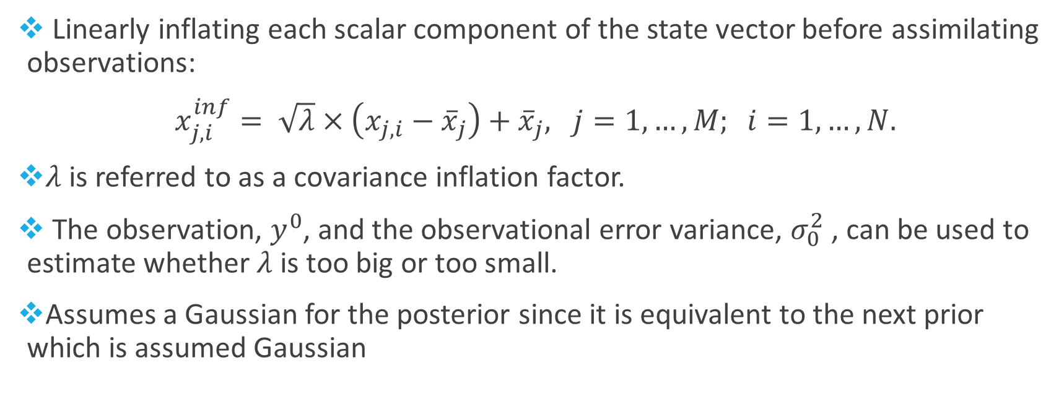
Covariance inflation
Linearly inflating each scalar component of the state vector before assimilating observations:
$x_{j,i}^{inf}= \sqrt{λ}×\left(x_{j,i}−{\overline{x}}_{j}\right)+{\overline{x}}_{j}, j=1,…,M; i=1,…, N.$
$λ$is referred to as a covariance inflation factor.
The observation, $y^{0}$, and the observational error variance, $σ_{0}^{2}$, can be used to estimate whether $λ$ is too big or too small.
Assumes a Gaussian for the posterior since it is equivalent to the next prior which is assumed Gaussian

Slide 8
Covariance inflation factor
Initially, it is assumed that the ‘model’ time tendency for 𝜆 is 0.

Slide 9
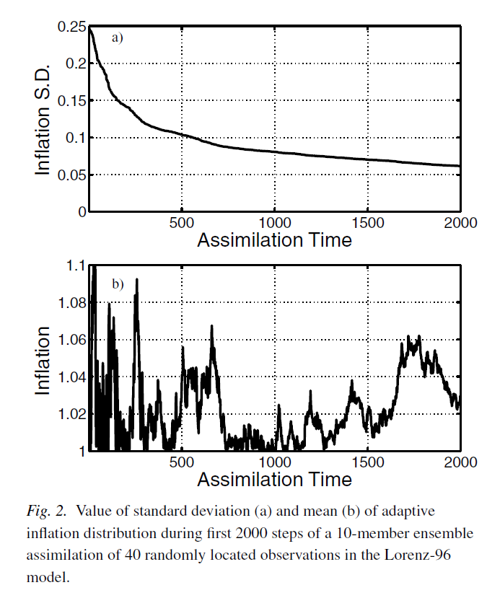
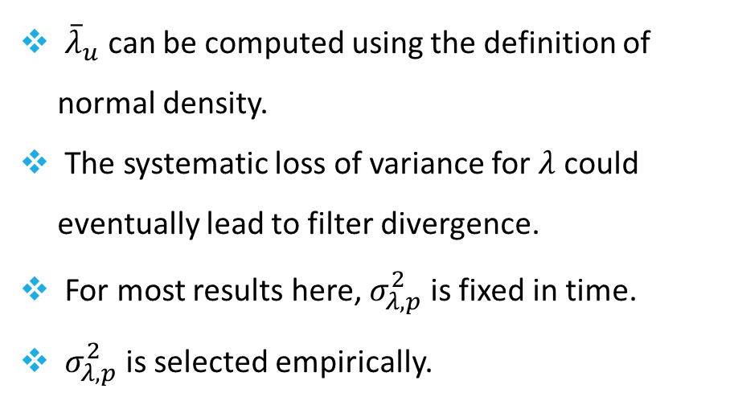
Update variance
${\overline{λ}}_{u}$ can be computed using the definition of normal density.
The systematic loss of variance for $λ$ could eventually lead to filter divergence.
For most results here, $σ_{λ,p}^{2}$ is fixed in time.
$σ_{λ,p}^{2}$ is selected empirically.

